Slide 1
HR Payroll System
Originally known as BEACON
Notes:
Orientation Manual Page: 9
We will begin by spending some time on the HR Payroll System.

Slide 2
HR Payroll System
Was formerly known as BEACON.
Personnel ID Number (PERNR)
Used to track time, benefits, and process payroll.
Position Settings
Employee Self Service (ESS) Training
Notes:
Orientation Manual Page: 9
In April 2008, most state agencies began utilizing a new Payroll System. The project name during the transition was BEACON which stood for
Building Enterprise Access for NC’s Core Operation Needs. You will still hear the term BEACON used for the HR Payroll System.
As a new employee, you will be assigned a Personnel ID number, often called a PERNR. This number will serve as your ID number while you are an active employee and even as a retiree.
The HR Payroll system is an integrated system that is used to track time, benefits, and process payroll. This means it is very important for all of us to make sure that information is this system is accurate.
The Office of State Controller has developed an instructional course titled Employee Self Service (ESS) Overview to help familiarize all employees with the ESS portal. New employees are required to complete the ESS Overview training as part of new hire orientation. This training is three hours of training credit.

Slide 3
Position Settings
Each employee’s position has the following designations:
A designated, predefined work schedule;
A holiday calendar;
A work period;
Position settings which determine eligibility for overtime / compensatory time, shift premium pay, on-call/emergency call back, and holiday premium rate.
Based on these settings OT, Comp Time, Shift Premium, etc. are automatically calculated.
The position settings and time entry are the foundation for how an employee’s time is processed and paid in the HR Payroll System.
Notes:
Orientation Manual Page: 9
Each employee’s position has the following designations:
• A designated, predefined work schedule;
• A holiday calendar;
• A work period;
• Position settings which determine eligibility for overtime/compensatory time, shift premium pay, on-call/emergency call back, and holiday premium rate.
Based on these settings, Beacon will automatically calculate OT, Comp Time, Shift Premium, etc.
Therefore, the position settings and time entry are the foundation for how an employee’s time is processed and paid in Beacon SAP.

Slide 4
Employee Self Service
ESS Without Time Entry
ESS With Time Entry
Access to enroll and update benefit and other employee information,
Will NOT be entering work time, leave, or submit leave requests in ESS.
Access to enroll and update benefit and other employee information,
Authorized to enter their time and leave in ESS.
Notes:
Orientation Manual Page: 10
The HR Payroll System offers a self-service option known as Employee Self Service. DPS employees have access to ESS in either one of two ways.
The majority of employees in DPS have access to ESS without Time Entry. ESS without Time Entry means employees will have access to enroll and update benefit and other employee information, however, will NOT be entering work time, leave, or submit leave requests in ESS.
Certain DPS locations have been authorized to have access to ESS with Time Entry. In addition to having access to enroll and update benefit and other employee information, employees at these locations have been authorized to enter their time and leave in ESS.
Please refer to your supervisor and/or manager to determine whether you have ESS with or without Time Entry.

Slide 5
Employee Self Service
My Personal Data
Update/change Address
Update/change Tax Withholdings
Add/update Family Member Dependents
Change Bank Information
My Working Time
Enter working time (for authorized locations)
Request leave from supervisor
View/print Leave Quota balances
My Pay
View/print past & current Pay Statements
Access multi-year W-2 information
My Benefits
Enroll in State Health Plan & NCFlex programs
Add/change beneficiary info for NCFlex
Access 401K & Deferred Comp websites for enrollment
Notes:
Orientation Manual Page: 10
Employees can access ESS online at https://mybeacon.nc.gov .
Under “My Personal Data,” you can update/change address information, tax withholding information, add/update family member dependents and change bank information.
Under “My Working Time,” you can enter working time and leave, request leave from your supervisor, and view and print your leave quota balances. Remember, ONLY employees at locations that are authorized to enter time/leave shall enter work time and make leave requests in ESS.
“My Pay” allows you to view/print past and current pay statements. You can also access W-2 information.
“My Benefits” allows you to enroll in the State Health Plan and NCFlex programs. You can add/change beneficiary information for NCFlex and also access the 401K and Deferred Comp websites.
As we explained earlier, information about ESS will be explained in more details during the ESS Overview training.

Slide 6
Manager Self Service (MSS)
At locations authorized to enter Time/Leave in ESS, managers/supervisors with MSS will be able to:
Review & approve time entry of employees;
Review & approve leave requests;
Access to general information on employees;
Ability to run various Time Reports.
Notes:
Orientation Manual Page: 11
Manager Self Service will only be available at locations that have been authorized to enter Time/Leave in ESS because the primary function of MSS is to review and approve Time Entry.
Managers using MSS will be able to review and approve time entry of employees as well as approve leave requests. As a manager, MSS will give you access to general information on your employees and provide you the ability to run various Time Reports.

Slide 7
Time Entry & Evaluation
Time/ Leave is entered.
(Employee/ESS or Timesheet/Time Administrator)
HR Payroll system runs nightly Time Evaluation to update & check for errors.
Leave is adjusted according to the Leave Hierarchy
Time Entry info is processed into payroll.
Note: Employees entering their time in ESS must enter, save & release their time and managers must approve.
Notes:
Orientation Manual Page: 12
This diagram shows how time and leave translate in to Payroll.
Once time/leave has been entered into the system either by the Time Administrator or by the employee via ESS, the HR Payroll system will run a nightly Time Evaluation. Time Evaluation determines:
• Overtime/Compensatory Time
• Premium Pay
• Leave Offsets and
• Recovery of Liabilities
Time Evaluation checks for time entry errors, updates the time/leave records that were entered and approved. These results are used to generate your pay.
Leave is than adjusted/updated according to the leave Hierarchy which we will discuss later.
Then Time Entry information is processed into payroll.
Please keep in mind that this is a brief overview of how time entry affects pay. Factors such as position settings, pay cycles, overtime periods, payroll deadlines, leave offsetting, etc. will also affect pay.

Slide 8
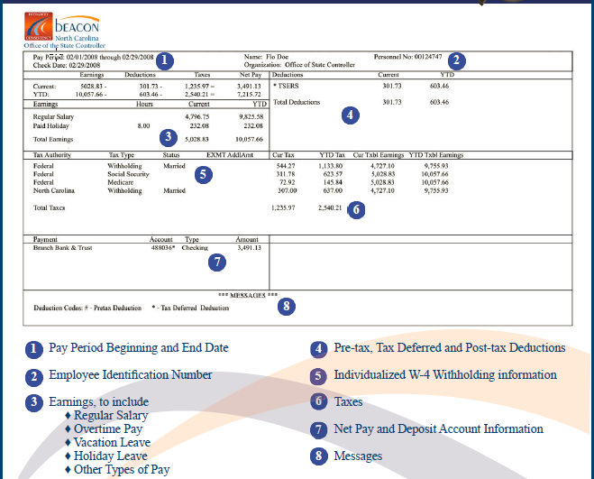
Pay Statement
Notes:
Orientation Manual Page: 17
Employees can print their own pay statements from ESS.
Pay statements will include information such as the beginning and ending date of the pay period (monthly or bi-weekly), your employee ID number, and your total earnings and net pay. There will be a line item for “Total Base Pay” which as we explained should be approximately the same each month. There will also be a line item for “Total Other Pay” which is the sum of any supplemental pay (overtime, shift premium, etc.).
Pre-tax and post-tax deductions will be indicated as well as W-4 withholding information and taxes. Leave balances will be printed on pay statements for non-ESS employees.
Please note that it is state policy that all employees receiving their pay through Beacon must be enrolled in direct deposit.
More information on viewing and printing your Pay Statement in ESS will be provided in the ESS Overview training.

Slide 9
Your First Paycheck
DPS has monthly payroll deadlines. The date you report to work will affect when you get your first paycheck.
If you report to work and your paperwork is processed PRIOR to the payroll deadline for that month, you may receive a paycheck on the last working day of the month.
However, if you report to work and your paperwork is processed AFTER the payroll deadline for that month, you will receive a paycheck on the last working day of the following month. Pay from your first month’s work will be included in this paycheck.
Notes:
Orientation Manual Page: 18
DPS has monthly payroll deadlines. The date you report to work will affect when you get your first paycheck.
If you report to work and your paperwork is processed PRIOR to the payroll deadline for that month, you may receive a paycheck on the last working day of the month.
However, if you report to work and your paperwork is processed AFTER the payroll deadline for that month, you will receive a paycheck on the last working day of the following month. Pay from your first month’s work will be included in this paycheck.

Slide 10
HR Payroll System Questions/Problems
Consult with your Manager/Supervisor
Ask your location HR Representative
Contact Central HR (919) 716-3800
BEST Shared Services (919) 707-0707
Notes:
Orientation Manual Page: 18
If you have questions or problems related to the HR Payroll System, you can
Consult with your Manager/Supervisor
Ask your location HR Representative
Contact Central HR
BEST Shared Services
BEST Shared Services (BEACON Enterprise Support Team) is a the organization created to support the HR Payroll System community, including employees, managers, and agency HR.

